Slide 1

SOCIAL MEDIA ANALYSIS
Ashish Kumar
25-12-2025

Slide 2

ABOUT META
Meta Platforms, Inc. doing businesses as Meta and formerly named Facebook, Inc. The company owns and operates Facebook, Instagram, Threads and WhatsApp among other products and services.

Slide 3
AGENDA
01
02
03
04
05
Problem Statement
Data Description
Key Findings and Visualizations
Recommendations and strategies
Conclusion

Slide 4
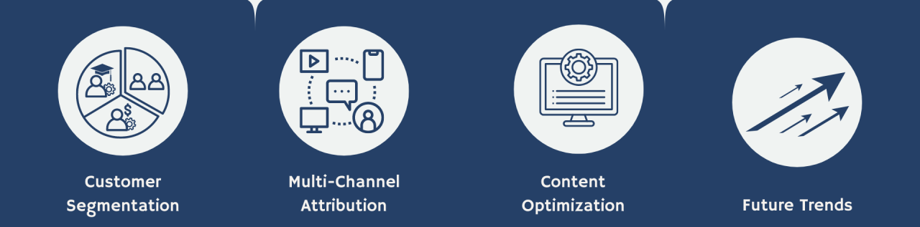
PROBLEM STATEMENT
Analyze and leverage Instagram's user data to develop targeted marketing strategies that will increase user engagement, retention, and acquisition.

Slide 5
DATA DESCRIPTION
Users:
id: Unique identifier for each users.
username: Name of the user.
created_at: Timestamp when the account is created.
Comments:
id: Unique identifier of each comment made to any photo posted.
comment_text: Comment made on the post.
user_id: id of the user who made the comment.
photo_id: id of the photo where the comment is made.
created_at: Timestamp of when the comment is made.
Photos:
id: Unique identifier of each photo uploaded.
image_url: web link of the photo uploaded.
user_id: id of the user who uploaded the photo.
created_dat: Timestamp of when the photo is uploaded.

Slide 6
DATA DESCRIPTION
Likes:
user_id: id of the user who made the like.
photo_id: id of the photo post being liked.
created_at: Timestamp of when the like is made.
Follows:
follower_id: id of the follower user.
followee_id: id of the followee user.
created_at: Timestamp of when the following happen.
Tags:
id: Unique identifier of each tag.
tag_name: Name of the tag
created_at: Timestamp of when the tag is created.
photo_tags:
photo_id: id of the photo that have been tag.
tag_id: id of the tag

Slide 7
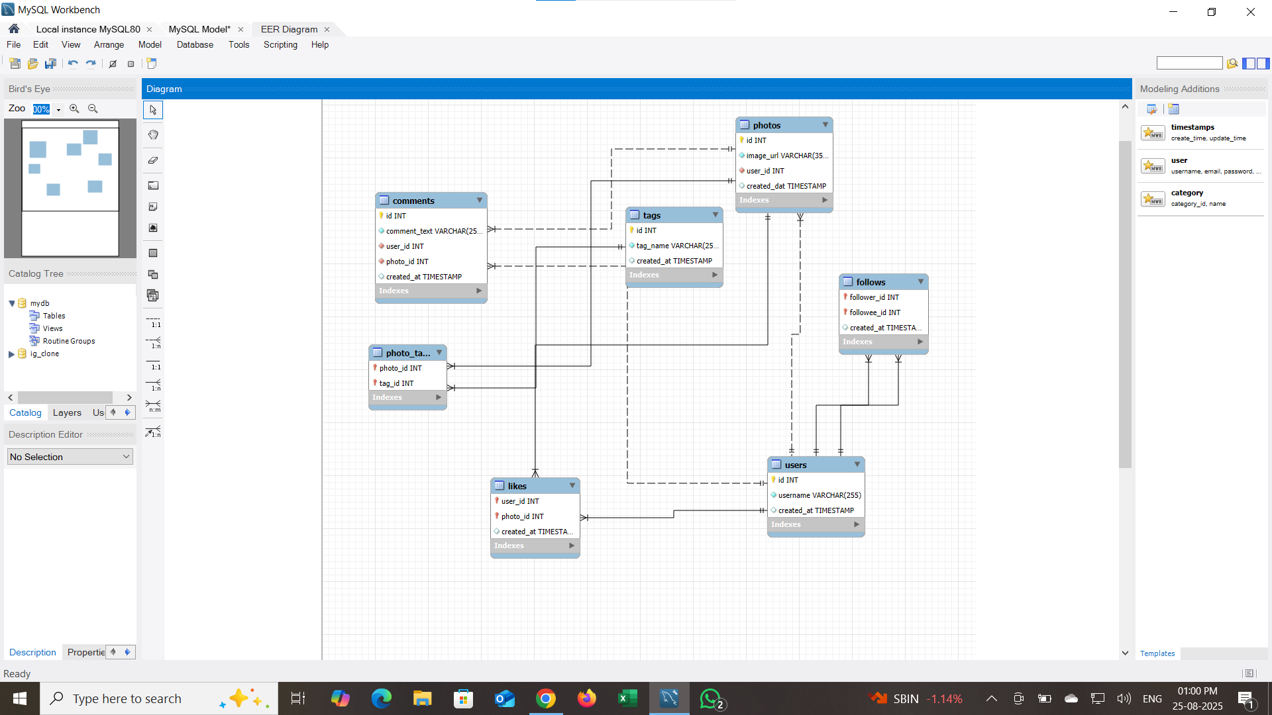
DATABASE SCHEMA

Slide 8
KEY FINDINGS
USER DISTRIBUTION BY ACTIVITY LEVEL
INSIGHTS:
Based on the segmentation, Majority of the users (77) falls into Highly Active segment, followed by Inactive users, and then Low Active and Moderately Active segment.

Slide 9
INACTIVE USERS
(Users at risk of churn.)
There are 13 users who fall into this category:
Kasandra_Homenick
Tierra.Trantow
Pearl7
David.Osinski47
Morgan.Kassulke
Linnea59
Franco_Keebler64
Hulda.Macejkovic
Darby_Herzog
Esther.Zulauf61
Bartholome.Bernhard
Jessyca_West
Esmeralda.Mraz57
These are the users who haven’t upload any post, like or comment on any post uploaded.

Slide 10
Hashtags with engagement rate
(What content themes perform best?)
INSIGHTS:
Food-related tags ("delicious," "foodie," "food") lead with the highest engagement (~64-65), indicating strong user interest in food content.
Visual and aesthetic tags ("beauty," "sunset," "stunning," "photography," "landscape," "style") also perform very well, reflecting appeal in artistic and scenic content.
Emotional and social tags ("smile," "party," "happy," "fun," "lol") show healthy engagement, emphasizing the value of relatable, joyful content.
Lifestyle and fashion tags ("hair," "concert," "fashion") have moderate engagement around 62.5-63, suggesting steady interest in these niches.

Slide 11
IDEAL USER FOR INFLUENCING MARKETING CAMPAIGN OR POTENTIAL BRAND AMBASSADORS
Ideal candidates for influencer marketing campaigns are users who have highest follower counts and strong engagement rates (many likes, comments per post).
USERNAME | FOLLOWER COUNT | AVG ENGAGEMENT RATE
Donald.Fritsch | 65.33 | 77
Aurelie71 | 65.25 | 77
Cesar93 | 64.6 | 77
Florence99 | 64 | 77
Jaime53 | 62.5 | 77
Eveline95 | 62.41 | 77
Kenton_kirlin | 62 | 77
Delfina_VonRueden68 | 62 | 77
Mariano_Koch3 | 61 | 77
Clint27 | 60 | 77
RECOMMENDATION:
Personalized Outreach: Contact the influencer(s) with tailored proposals, referencing both their follower reach and engagement impact.
Offer Value: Suggest benefits such as exclusive access, partnerships, or compensation to incentivize collaboration.
Creative Freedom: Empower influencers with flexibility in content creation for authenticity and better campaign results.
Long-Term Partnership: Consider ongoing ambassador roles for sustained brand visibility.
Performance Tracking: Measure influencer campaign effectiveness and refine selection/strategy based on future engagement metrics.

Slide 12
TOP 10 ENGAGED USERS
(Power users who drive most interactions.)
INSIGHTS:
These are the top 10 users with highest engagement score (count of post they made, and number of likes and comments on their posts)
RECOMMENDATION:
Assign reward tiers based on rank as:
Rank 1 🡪 'Gold - Exclusive Access + Gifts'
Rank 2-5 🡪 'Silver - Discounts + Badges'
Rank 6-10 🡪 'Bronze - Recognition + Small Perks'

Slide 13
REWARD STRATEGY FOR ENGAGED USERS
RECOMMENDATION:
Focus on nurturing and rewarding Highly active segment via exclusive perks, content creator programs, and brand ambassador roles.
For inactive user segment, deploy win-back campaigns, personalized notifications, and incentives to reactivate.
Encourage gradual increase in participation with gamification and tailored content for low active segment.
Investigate definitions or consider regrouping for better balance for moderately active segment.

Slide 14
RE-ENGAGEMENT STRATEGY FOR INACTIVE USERS
RECOMMENDATION:
(To re-engage them and encourage them to start posting or engaging again)
1.Identify Inactive Users
2.Personalized Outreach (Remind with emails or push notifications.)
3.Incentivize Return (Offer bonuses, sneak peeks, or exclusive content.)
4.Simplify Posting (Provide templates or suggestions for easy content creation.)
5.Reward First Action (Give badges, points, or discounts.)
6.Gamify Participation (Run contests, challenges, or giveaways.)
7.Inspire with Peers – (Highlight trending or popular posts from others.)
8.Personalized Feed – (Show hot topics and relevant interests.)
9.Provide Support – Offer quick help or tips to resolve issues.
10.Measure & Optimize – (Track re-engagement and refine strategies.)

Slide 15
CONTENT STRATEGY
RECOMMENDATIONS:
Create and promote content focused on highly engaging themes like food and visual beauty to maximize user interaction.
Use these top hashtags strategically in posts and ads to increase reach and visibility.
Combine popular tags with emotional or social themes to make content more relatable and shareable.
Track changes in engagement scores over time to stay updated with evolving trends.
Design ads around high-performing content topics for better resonance and effectiveness.
Use data-driven selection of hashtags in sponsored posts to boost ad ROI.
Regularly update hashtag analysis to spot emerging topics.
Suggest high-engagement hashtags to users during posting to help them get discovered, increasing platform-wide engagement.

Slide 16

CONCLUSION:
The analysis highlights clear opportunities to boost engagement by focusing on highly active users while re-engaging inactive ones.
Food, visual, and emotional content drive the highest interaction, making them ideal themes for targeted campaigns.
Influencer partnerships with users having both reach and engagement potential can amplify brand visibility.
Segment-based strategies (active, low active, inactive) ensure a personalized and effective approach to user retention and growth.
Overall, leveraging these insights can enhance marketing ROI, strengthen community bonds, and sustain long-term user acquisition.

Slide 17


